Slide 1
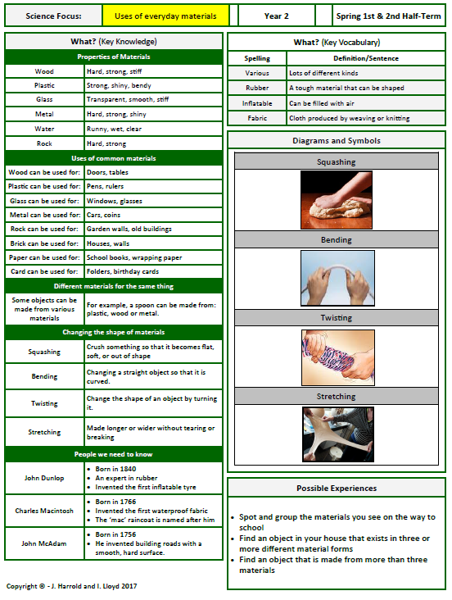
Knowledge Organiser
Autumn 2

