Slide 1
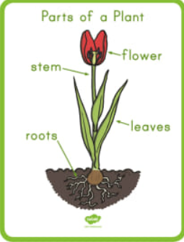
Knowledge Organiser
Science Focus | Plants | Year 1 | Spring 2
What? (Key Knowledge)
Leaf | The leaf makes food for the plant by photosynthesis.
Stem | The stem supports the leaves and is also part of the plant’s transport system.
Buds | Buds are undeveloped shoots.
Flower | Some buds produce flowers. These are shoots specialised for reproduction.
Roots | Roots anchor the plant to whatever material it is growing on or in. They also absorb water and other chemicals that the plant needs in order to live healthily and grow normally.
Trees | Ash, birch, beech, rowan, common lime, oak, sweet chestnut, horse chestnut, apple, willow, sycamore, fir, pine , holly, etc
Wild flowers | Daisy, dandelion, clover, shepherd’s purse, thistle, and nettle.
Garden flowers | Rose, carnation, crocus, daffodil, bluebells, etc
Statutory requirements
- Identify and name a variety of common plants, including garden plants, wild plants and trees, and those classified as deciduous and evergreen - Identify and describe the basic structure of a variety of common plants including roots, stem/trunk, leaves and flowers.
What? (Key vocab)
Spelling | Definition
Deciduous | A tree or shrub that sheds its leaves annually, usually in autumn.
Evergreen | A plant that retains green leaves throughout the year.
Pollen | A fine powder produced by flowers. It fertilizes other flowers of the same species so that they produce seeds.
Seed dispersal | The movement, spread or transport of seeds away from the parent plant.
Blossom | The flowers that appear on a tree before the fruit.
Diagrams
Possible experiences
Grow your own sunflowers - observe the seeds and predict what they may be and if they are living or non-living. Seeds could then be planted in Spring and children could make observations each week by drawing what they see. Challenge misconceptions that all living things have to move around. Watch how plants move to face the sun. Grow edible plants - Children may think that vegetables are not part of the plant kingdom. Observe the vegetable plants and identify which part of the plant we eat – leaves, stem, root. Radishes are quick to grow and a great favourite of Peter Rabbit. Lettuce, carrots, beans or peas are also all great fun to grow with children.

