Slide 1
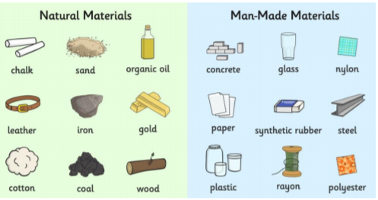
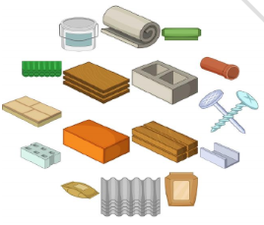
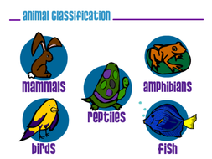
Knowledge Organiser
Science Focus | Everyday materials | Year 1 | Spring 1
What? (Key Knowledge)
Materials | Materials are what objects are made from. We create objects by treating and shaping materials in different ways.
Properties | Properties of a material are what we can measure, see and feel. The properties can be changed through heating, cooling and other methods.
We can use our 5 senses to explore materials | Our 5 senses are: touch, taste, smell, sight and hearing. We touch using our skin (usually our hands) We taste using our tongues by putting something in our mouth We smell by using our nose We see using our eyes We hear using our ears
Statutory requirements
Distinguish between an object and the material from which it is made. Identify and name a variety of everyday materials, including wood, plastic, glass, water and rock. Describe the simple physical properties of a variety of everyday materials. Compare and group together a variety of everyday materials on the basis of their physical properties.
What? (Key vocab)
Spelling | Definition
Material | What somthing is made out of. Examples include: wood, plastic, glass, metal, water, rock, brick, fabric, sand, paper, flour, butter, milk, soil.
Property | Words to describe what we can measure, see and feel about a material. Examples include: hard/soft, stretchy/not stretchy, shiny/dull, rough/smooth, bendy/not bendy, transparent/not transparent, sticky/not sticky.
Texture | The feel, appearance, or thickness of something. Examples include: smooth, rough, sharp, runny.
State | Is the material a solid, liquid or gas?
Pictures and Diagrams
Possible experiences
Finding and classifying objects around the classroom according to the material from which they are made Feely bags of different textures to explore Sorting objects according to property Observing changes in materials through heating and cooling (freezing water to make ice, melting chocolate, ‘Will it melt?’ experiments) Observing changes through cooking (baking biscuits, making ice cream) Simple tests (making the best umbrella, Humpty Dumpty crash mats)

