Slide 1
__________’s going on holiday story
Photo of young person

Slide 2


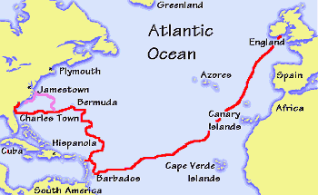

______ is going on
holiday with
__________ to a
hotel in Barbados.

Slide 3
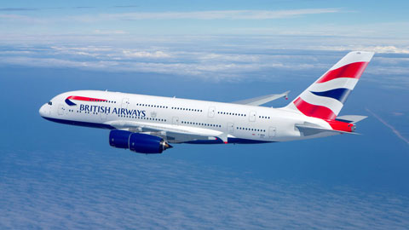
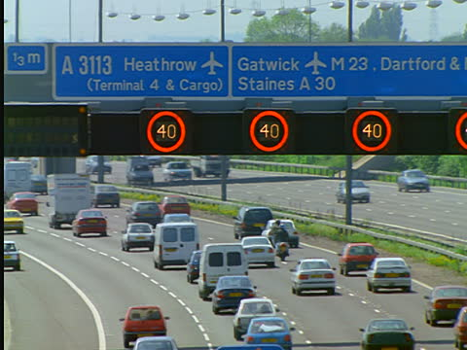
_________ will travel from home to _________Airport on the motorway.
The journey will take a long time.

Slide 4
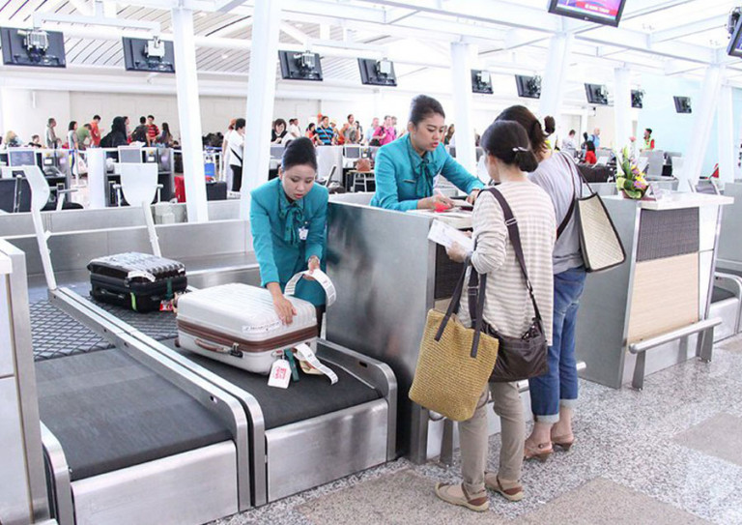
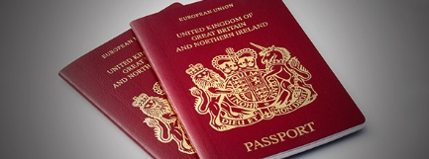
____________ will give our suite cases to the airline staff.
We will show the airport officers our passports and travel documents.

Slide 5
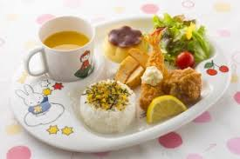
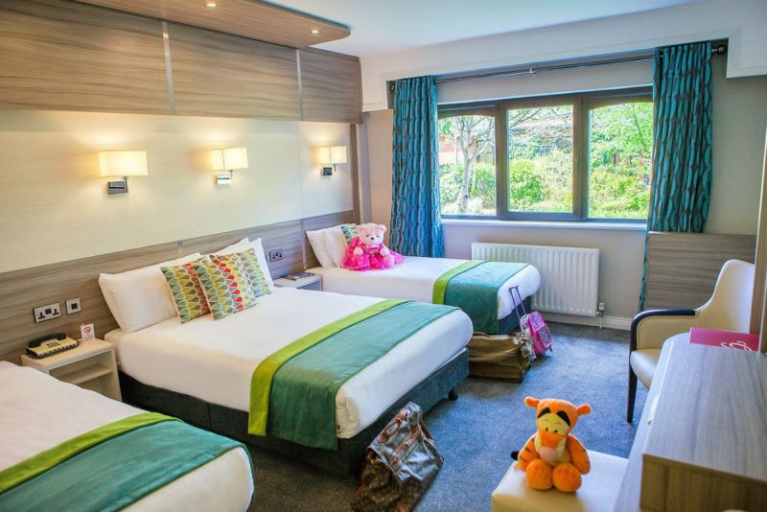


At the hotel ____________ will sleep in the hotel room.
__________ will have meals in the restaurant.

Slide 6
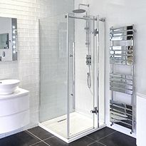
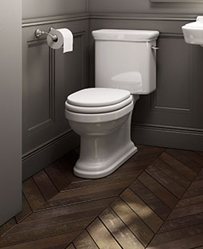
In the hotel _________ will have to wash in the bathroom.
In the hotel _________ will have to use the toilet to wee and to poo.

Slide 7
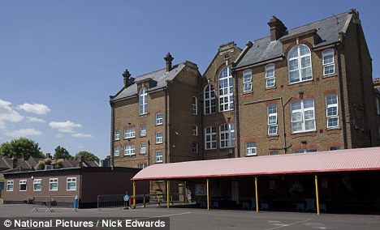

When __________ is in Barbados there will be no school.

Slide 8
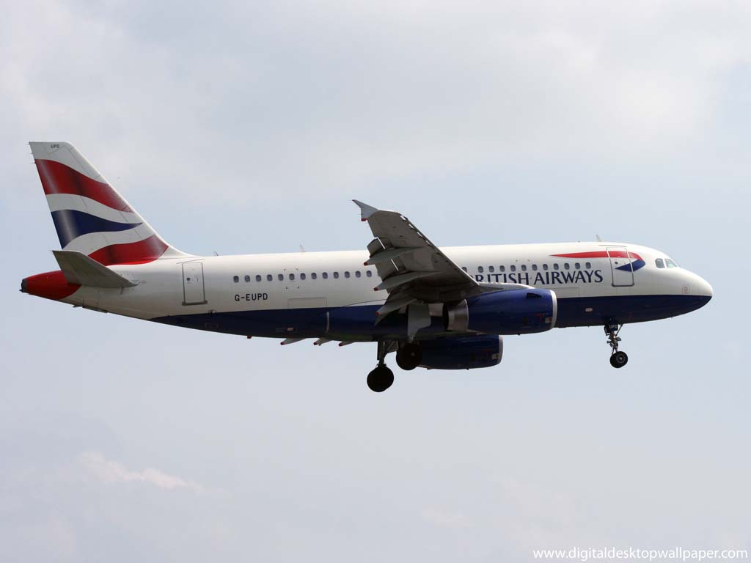

When the holiday is finished __________ will travel back home.
Photo of home

Slide 9

When __________ is back at home he will be going to school.

Slide 10
Created by the
SENDCo

