Slide 1

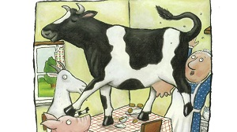
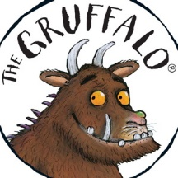
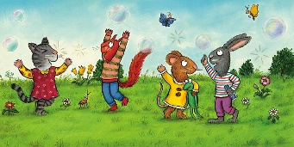




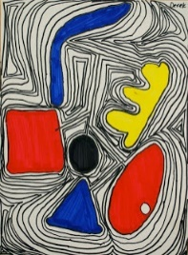
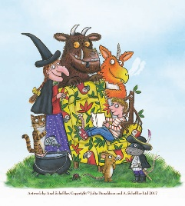
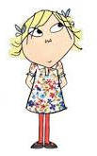
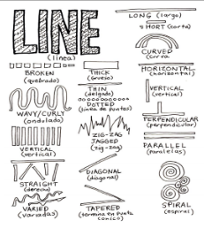
Spring Trust Academy – Knowledge Organiser
Art Focus | Drawing | Year 1
Who? Focus Famous Artist
Alex Scheffler | Illustrator of famous children’s books (Julia Donaldson). Born in Hamburg, Germany in 1957. Loved drawing at school.. Moved to London in 1986 and started illustrating. First book 1988 The Piemakers by Helen Cresswell. 1992 first Julia Donaldson book – A Squash and a Squeeze. 2012 – designed Christmas stamps for Royal Mail. 2020 –developed rhyming couplets illustrations based upon Corona Virus. Cartoon like style of illustrations. Scheffler sketches his drawings in pencil and traces them on watercolour paper on a light box. Then adds the outlines in ink and colours them in.
Who? Additional Artists
Lauren Child | Illustrator of famous children’s books (Charlie & Lola)
Alexander Calder | He enjoyed working with wire and in 1931 created his first truly kinetic sculpture.
What? Key vocab
Broad | A large width
Narrow | A small width
Detail | Small pieces of information
Image | A representation of a something drawn
Mirror | Show a reflection of
Charcoal | A black solid, made of carbon,
Shape | A geometric figure
Fine | Very thin or narrow
Pattern | A repeated decorative design
Tone | The lightness or darkness of a colour
What? Key Skills
To draw images from observation, experience and imagination. To use a range of materials, including pencils, chalk, charcoal, pastels, etc. To develop their use of space, composition and proportion. To begin to understand tone.
Pictures and Diagrams

