Slide 1
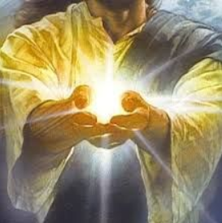
R.E. – Knowledge Organiser – Revised 2021
RE Focus | Christianity: The Creation Story | Year 1 | Autumn 1
What? (Key Knowledge)
The Creation Story | In the beginning - God started creation. The first day - light was created. The second day - the sky was created. The third day - dry land, seas, plants and trees were created. The fourth day - the Sun, Moon and stars were created. The fifth day - creatures that live in the sea and creatures that fly were created. The sixth day - animals that live on the land and finally humans, made in the image of God, were created.
Adam and Eve | The first two humans that God created to live on Earth. They were the last things to be created, and made to be like God on earth.
The seventh day of rest - Sunday | On day seven - God finished his work of creation and rested, making the seventh day a special holy day. For Christians, this is Sunday. The seven days make up one week.
Attainment Targets
I can say how it felt to make something. I can remember the Christian Creation story and talk about it. I can express an opinion about the Christian belief about creation.
Key Questions
Does God want Christians to look after the world? Does the world belong to God? Should people take care of the world? How do you think people should treat the world? What do you believe about how the world was created?
What? (Key vocab)
Spelling | Definition
Creation | Making something new.
God | In Christianity, the creator and ruler of the universe and source of all moral authority; the supreme being.
Light | God said ‘let there be light!’ on the first day he created the world. Light allows for living things to grow and thrive.
Awe | Seeing something that makes you feel amazing or scared.
Wonder | A feeling of amazement or love.
Possible experiences
Act out the creation story Outdoor learning - Use chalks to draw a class picture of the world being created. Explain what your favourite thing about the world is.

