Slide 1
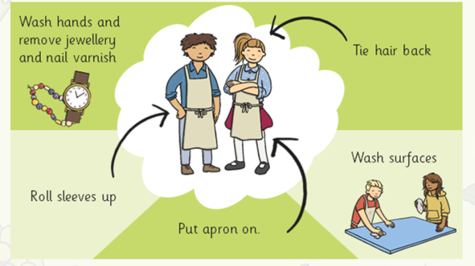
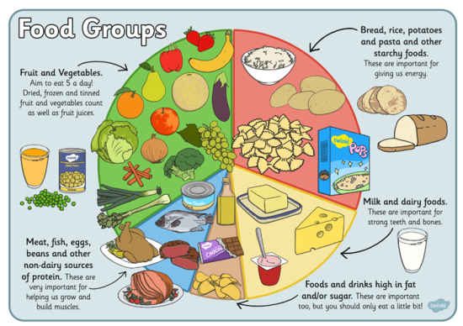
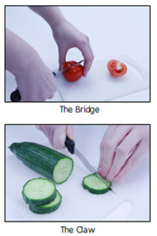
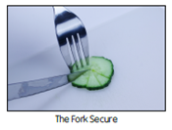
Spring Partnership Trust – Knowledge Organiser
DT Focus | Food | Year 1
Salads Design Brief Design and make a salad that supports a healthy balanced diet.
What? Key Skills
Design | Make | Evaluate
To use the basic principles of a healthy and varied diet to prepare dishes. To demonstrate an understanding of where food comes from. | To follow safe procedures for food safety and hygiene. To cut, slice, peel, grate and juice ingredients safely. To combine ingredients in different ways, eg mixing, stirring, folding, etc | To explore and evaluate a range of existing salads, identifying likes and dislikes and suggesting improvements.
Key Vocabulary
Design Brief | a description of what a new project or product should do and what is needed to produce it
Design | a plan to show the look and function or workings of a product before it is made
Make | create something by putting parts together
Evaluate | to judge the quality of a product and how well it meets the design brief
Fruit | the fleshy product of a tree or other plant that contains seed and can be eaten as food
Vegetable | a plant or part of a plant used as food, such as a cabbage, potato, turnip, or bean
Healthy | when something forms part of a balanced diet and is considered to be good for our health
Seasonal | something that is ready to eat during a particular season of the year
Food Hygiene | the measures we take to ensure that food is safe to eat
Recipe | a set of instructions we follow to make a food product or meal
Peeling | to remove the outer coating of skin from fruits or vegetables
Grating | to create small shreds of food by rubbing it on a grater
Mixing | to combine or put ingredients together to form a mixture
Juicing | to remove the juice from a piece of fruit
Food Hygiene/Safety
Pictures and Diagrams
Cutting techniques

