Slide 1
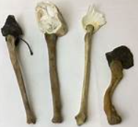
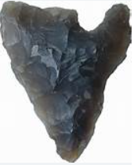
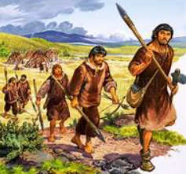
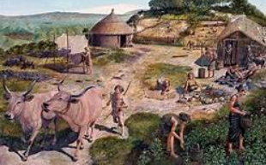
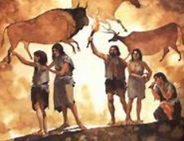
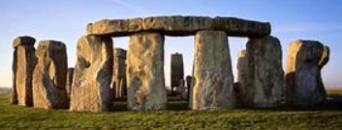
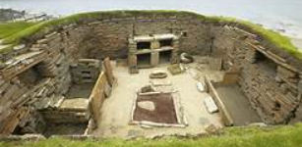
Spring Trust – Knowledge Organiser
History Focus | Stone Age | Year 1 | Spring
What? (Key vocab)
Spelling | Definition
Stone Age | Periods of time when tools were first discovered and they were made of stone.
Prehistoric | Before written records began.
Hunter- gatherer | Someone who hunts animals and gathers wild food to eat.
Archaeologist | A person who studies buildings, graves, tools and other objects belonging to people who lived in the past.
BC | Before Christ. A way of dating years before the birth of Jesus. The bigger the number BC, the longer ago in history is was.
Farmers | The early farmers chopped down trees so they could grow crops and vegetables. They kept cattle, sheep and pigs
Background Information
The Stone Age is the period of time after The Ice Age. During this period people used stone to make tools. It covers a huge period of time - over 3 million years and can be broken down into 2 smaller time periods: Palaeolithic ‘New Stone Age’ - around 3,000,000 BC. Early humans used simple stone tools to hunt food. Neolithic ‘Old Stone Age’- around 4500-2400 BC. During this period people became farmers and began to settle in villages.
When? (Key Knowledge)
3,000,000 BC Palaeolithic ‘New Stone Age’ | Early humans used simple stone tools
10,000 BC | Humans were hunter-gatherers and constantly on the move in order to stay safe and find food.
4500-2400 BC Neolithic ‘Old Stone Age’ | Farming developed and villages were built.
3000 BC | Stonehenge started to be built.
3000 BC | The first stone age village, Skara Brae was built.
Who?
Cave people | Early prehistoric people who lived in caves.
Palaeolithic people Early Stone Age | People used tools to hunt. They found food by roaming from place to place.
Neolithic people Late Stone Age | Farming developed and villages were built.

