Slide 1
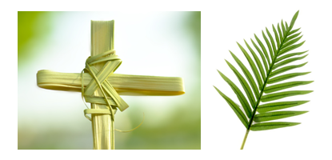
R.E. – Knowledge Organiser – Revised 2021
RE Focus | Christianity: Palm Sunday | Year 1 | Spring 2
What? (Key Knowledge)
Why was Jesus welcomed like a king? | The people welcomed Jesus like this because they had heard about all the amazing things He did e.g. healing people, calming the storm etc. They believed He would be the ‘Messiah’, the one who would save them from the Roman occupation.
Why is Jesus special to Christians? | He is special to Christians because they believe He is the Son of God.
Palm Sunday | Palm Sunday is the story of when Jesus travelled into Jerusalem on a donkey. Jesus chose a donkey because they are gentle and peaceful. Crowds started to come out to greet Jesus. People waved and screamed and treated him like a king. They shouted ‘Hosanna’ and laid palm leaves down for him to travel over. The palms were a sign that Jesus was a king. Jesus entered the temple at Jerusalem and healed the blind and the lame. The Jewish leaders were jealous that Jesus was so popular.
What happened after Palm Sunday? | Jesus was put to death on a cross but he came back to life again on Easter Sunday.
Attainment Targets
I can talk about a person I admire. I can recall parts of the Easter story. I can recognise some symbols in the story. I can start to show understanding that Jesus is special to Christians and say why.
Key Questions
Why was Jesus welcomed like a king on Palm Sunday? Why would non-religious people have still welcomed Jesus? How should people be welcomed? Why did Jesus ride a donkey? Jesus arrived as a king, but did He leave as one? Who do you admire? Why?
What? (Key vocab)
Spelling | Definition
Welcome | A way of greeting someone in a polite or friendly way.
Palm leaf or palm cross | A leaf thrown in front of Jesus and a cross made in church.
Disciple | A personal follower of Jesus.
Hosanna | An expression of joy or praise shouted at Jesus.
Possible experiences
Learn a Palm Sunday hymn/song e.g. ‘Sing Hosanna’ to sing during role play. Outdoor learning – Use natural materials to make palm leaves & re-enact Palm Sunday. Write words on palm leaves to reflect how Jesus would be welcomed.

