Slide 1

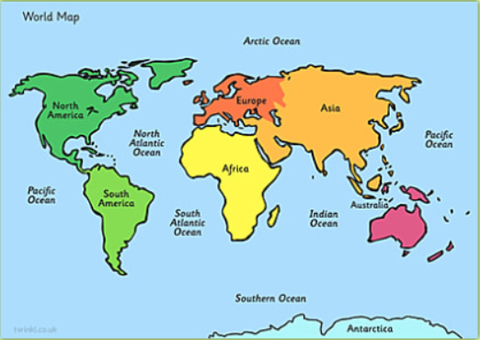
Midfield Primary School – Knowledge Organiser
Geography Focus | Continents and Oceans | Year 1 | Spring
What? (Key Knowledge)
Continents | Asia Europe Africa South America North America Oceania/ Australasia Antarctica (The arctic is not a continent because there is no land, only sea ice)
Oceans | Atlantic Pacific Southern Arctic Indian
Equator | The Equator runs around the centre of the Earth
 | The Northern Hemisphere is north of the Equator
 | The Southern Hemisphere is south of the Equator
 | The sun’s energy is most intense at the Equator, and so it is hot.
 | The further you move away from the Equator, things get colder, as the energy becomes less intense.
What? (Key vocab)
Spelling | Definition
Country | A nation with its own government
Continent | A large land mass, usually made up of a group of countries.
Equator | The Equator is an imaginary circle around Earth. It divides Earth into two equal parts: the Northern Hemisphere and the Southern Hemisphere.
Ocean | A large body of sea water
Globe | A name for our Earth
Northern Hemisphere | The half of the earth North of the Equator
Southern Hemisphere | The half of the earth South of the Equator
North Pole | The most northern part of the world
South Pole | The most southern part of the world
Weather | Daily changes in temperature, rain, wind etc
Climate | What the weather is like over period of time.
Diagrams and Symbols
Possible experiences
Can use atlases to research the continents and oceans. Children to stick photos of animal (polar bear, camel, etc) onto a world map reasoning what environment (hot cold temperate) they need. Can the children label a map with a key identifying the continents and oceans. Cut the world map into a jigsaw, can children put them back together.

