Slide 1
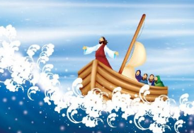
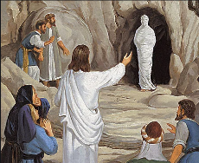
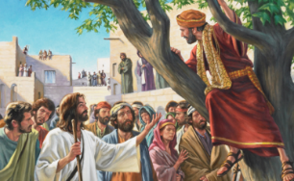
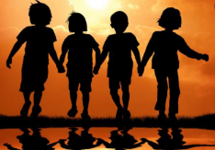
R.E. Knowledge Organiser – Revised 2021
RE Focus | Christianity: Jesus as a friend | Year 1 | Spring 1
What? (Key Knowledge)
Story of Zacchaeus | https://www.bedtimeshortstories.com/zacchaeus-story Zacchaeus was hated because he was a tax collector. He wanted to see Jesus so he climbed up a tree. Jesus saw him and asked to visit his house. This made people very unhappy. After seeing Jesus Zacchaeus said that he would give money to the poor!
Mary, Martha and Lazarus | https://bibleforchildren.org/PDFs/english/Jesus_and_Lazarus_English.pdf Lazarus was very sick, so Mary and Martha (his sisters) asked for Jesus` help. Jesus loved them and so said that he would. Unfortunately Lazarus died, but Jesus was able to bring him back to life!
Calming the storm | https://www.youtube.com/watch?v=uYLHqdSO9OY Jesus and his friends needed to travel by boat across the lake. During the trip, Jesus feel asleep, but then a fierce storm developed. Jesus` friends woke him up – Jesus was able to calm the storm.
Attainment Targets
I can talk about my friends and why I like them. I can remember a story about Jesus showing friendship and talk about it. I can say how Jesus tried to be a good friend.
Key Questions
Was it always easy for Jesus to show friendship? How do you show friendship? Can you name a famous person who was a good friend? Did God help Jesus show friendship even when it was difficult?
What? (Key vocab)
Spelling | Definition
Friend | Someone with who you have a bond or you care for. Normally not in your family.
Zacchaeus | A tax collector who wasn`t liked by most of the people.
Tax | A sum of money that you have to pay.
Lazarus | A man that Jesus brought back from the dead.
Bible | The Christian holy book that retells the story of Christianity.
Possible experiences
Act out key Bible stories Have a guest speaker discuss the stories. Outdoor learning – Use natural materials to create a recipe for the perfect friend.

