Slide 1
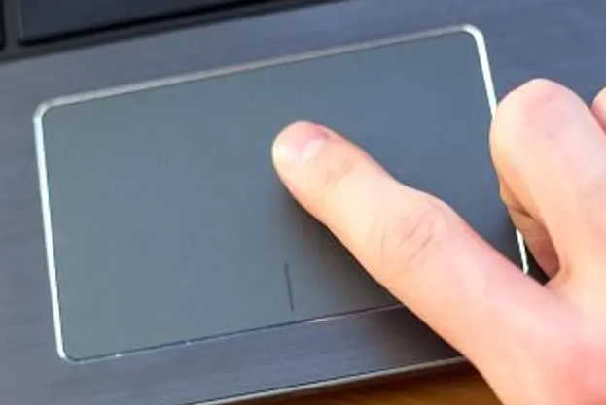
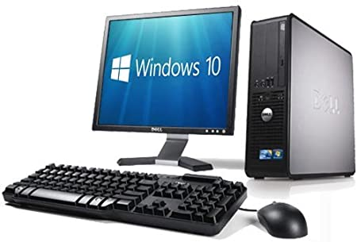
Spring Trust – Knowledge Organiser
Computing Focus | Introduction to computers | Year 1 | Spring 1
What? (Key Knowledge)
Computers in everyday life | Computers are found all around us; in the kitchen, supermarket, school or even on the street. These computers don’t look like laptops or desktops but can follow instructions and do lots of useful things.
Using a Chrome book | In school there are lots of Chromebooks available for children to use. Pupils need to learn how to use them and look after them properly.
Computer accessories | There are lots of devices that are used with computers like microphones, speakers, printers, webcams etc. It’s important to know what these are called and what they do.
What? (Key vocab)
Spelling | Definition
Computer | A type of machine that can follow instructions and do lots of useful things.
Login | Entering your username and password so you can get to your files and apps.
Signout | When you have finished using a computer, you do this to stop others from getting to your files and apps.
Shutdown | Switch the computer off.
Chromebook | A type of laptop made by Google.
Touchpad | An area on the laptop that lets you use your fingers to move the pointer around and open or close apps.
Touch screen | A touch sensitive screen that you can click on or drag.
Windows | Rectangles on a computer screen that apps run in.
Computer accessories | Other things that you use with a computer.
Files | Work, pictures, music or videos that you have downloaded or created.
Apps | Programs that let you do different things like play videos, type, draw etc..
Laptop | A laptop is a computer that is easy to carry around.
Desktop | Larger computers with separate screens and keyboards that are used at a desk.
Skills
I can talk about how computers are used in everyday life.
I can login/signout of my Chromebook.
I can use a touchpad/touchscreen.
I can find, start and close an app.
I can control and resize windows.
I can identify common computer accessories.
Touchpad
Desktop computer

