Slide 1
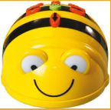
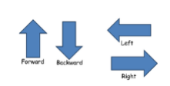
Spring Trust – Knowledge Organiser
Computing Focus | Introduction to Programming | Year 1 | Spring 1
What? (Key Knowledge)
Algorithm | An algorithm is a set of instructions that we complete in order to achieve a task. You could write an algorithm to complete mundane tasks such as making a cup of tea or to complete complex tasks such as calculating the odds that a team will win a football match. In computing an algorithm refers to the set of instructions that a computer follows in the order in which they are given.
What? (Key vocab)
Spelling | Definition
Instruction | A sequence of instructions/ algorithm written to perform a task
Algorithm | Is a set of step by step instructions used to carry out a task.
Debug | Checking a code works and makes changes to the program if it doesn’t.
Program | A program iis a set of instructions completed in order to complete a task.
Input | Information that goes into a computer
Output | Information that comes out of a computer.
Sequence | Instructions given in the correct order.
Data | Data is information
Skills
I can say what an algorithm is
I can create step by step instructions.
I can say instructions orally to program a beebot.
I can write down ny instructions to program a programmable toy with support.
I can check my work for mistakes (debug)
I can plan and check an algorithm
Diagrams and Symbols
Beebot

