Slide 1
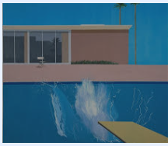
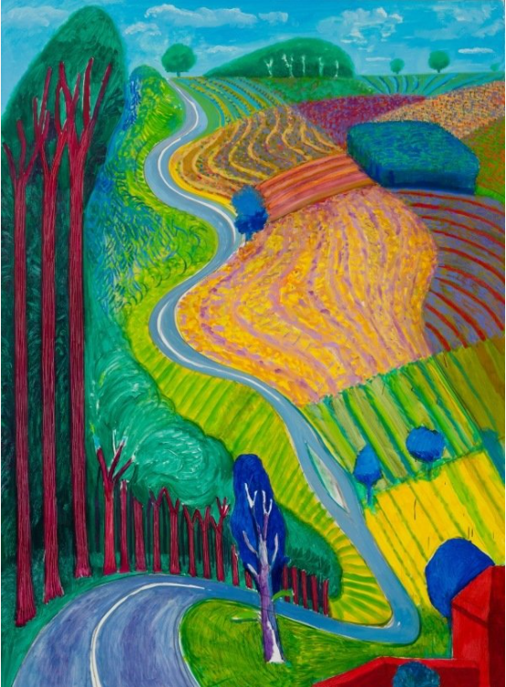
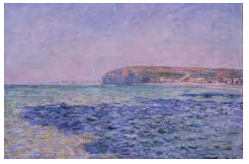
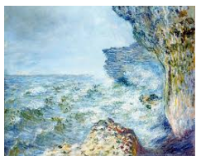
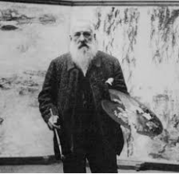
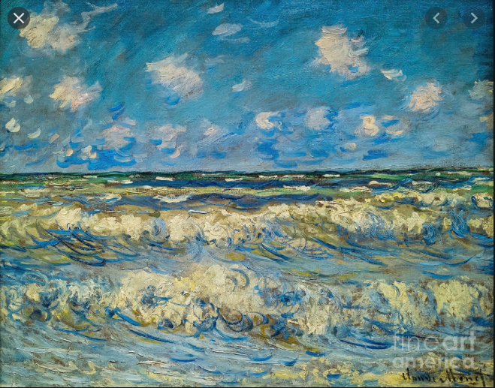
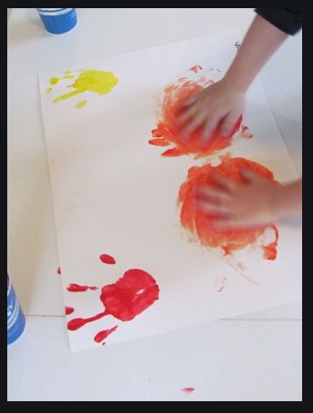
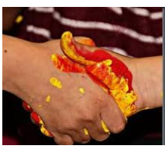
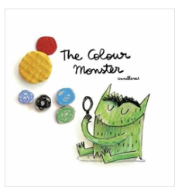
Spring Partnership Trust – Knowledge Organiser
Art Focus | Colour mixing | Year 1 | Autumn 2
Who? Famous Artists
David Hockney | David Hockney is one of the most important painters of the 20th century. Born in Bradford in 1937. Hockney was one of the artists involved in the pop art movement in the 1960s. Pop art was a style of art that was bright and full of colour. It was created by lots of young artists who felt that the art they saw in galleries was a little bit boring.
Claude Monet | Monet was born in Paris in 1840. As a child he showed great talent as an artist. In 1872 he painted a picture of a harbour using very loose brushstrokes. He called the picture Impression, Sunrise and exhibited it along with paintings by his friends. The artists became known as ‘the impressionists’ after the title of Monet's painting.
What? Key Skills
To study the work of other artists and talk about the techniques they have used. To develop ideas from starting points throughout the curriculum. To explore marks on paper, using a variety of tools and brushes to spread the paint. To experiment with colour and mixing, that a tint is a mixture of a colour with white and a shade is a mixture of a colour with black. To know the primary and secondary colours.
What? Key vocab
Primary colours | Colours that can not be created by mixing colours: red, yellow and blue.
Secondary colours | Colours made by mixing 2 primary colours together. e.g. red and yellow = orange
Tint | Adding white to a colour to make it lighter
Shade | Adding black to a colour to make it darker
Colour mixing | Mixing 2 colours to create a different colour e.g. blue and yellow = green
Pictures and Diagrams

