Slide 1
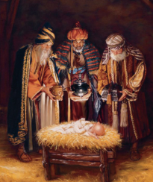
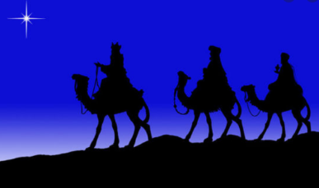
R.E. – Knowledge Organiser – Revised 2021
RE Focus | Christianity: The Christmas Story | Year 1 | Autumn 2
What? (Key Knowledge)
The Three Wise Men | The Three Wise Men were sent by King Herod to visit the baby Jesus. They arrived several days after the Baby Jesus was born and left him three gifts of Gold, Frankincense and Myrrh. Each gift tells us something about the Baby Jesus.
The Christmas Story - Nativity | The Christmas Story (Nativity) tells the story of how the baby Jesus was born and what happened before he was born. The baby Jesus’ parents were Mary and Joseph. Mary was told that she would have a baby by a special messenger sent by God. His name was the Angel Gabriel. The story also tells us about the shepherds who came to visit the baby Jesus. They were told to follow a star that stopped over the place the baby Jesus would be born by angels that visited them on the hillside. The baby Jesus was born in a manger as there was no room for Mary and Joseph to stay at the inn.
Attainment Targets
I can talk about a gift that is special to me. I can remember some of the Christmas story. I can suggest a gift I would give to Jesus.
Key Questions
What gift would I have given to Jesus if He had been born in my town and not in Bethlehem? How does it feel to give a gift? Can you name a famous person who you think is a gift to the world? Why were these gifts given to baby Jesus? Why do Christians believe Jesus is a special gift from God to the world?
What? (Key vocab)
Spelling | Definition
Bethlehem | The town where Jesus was born.
Gold | A gift from the three wise men. It showed that Jesus was a king.
Frankincense | A gift from the three wise men. It showed that Jesus was God on earth.
Myrrh | A gift from the three wise men. It meant that Jesus would one day die.
Lamb | A baby sheep. Some Christians refer to the baby Jesus as ‘the Lamb of God’.
Possible experiences
Retell the nativity story. Wrap your own present for the baby Jesus. Outdoor learning - Create natural Christmas tree decorations.

