Slide 1
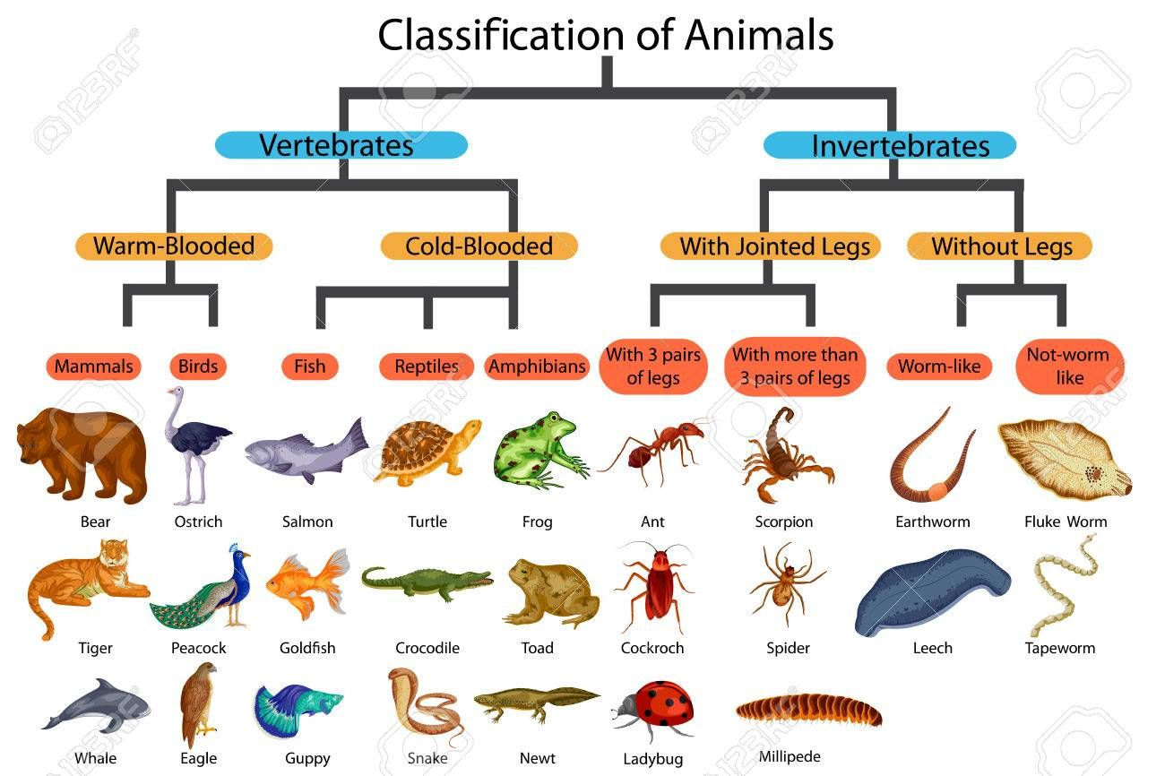
Knowledge Organiser
Science Focus | Living things and their habitat | Year 5 | Summer 1
What? (Key Knowledge)
Life cycle of animals | Most animals including fish, mammals, reptiles and birds have very simple life cycles: These animals have three stages -- before birth, young and adult. The young are typically similar to the parent, just smaller. The young slowly "grow" to become adults.
Amphibians | E.g. frogs and newts, have a slightly more complicated life cycle. They undergo a metamorphosis: they are born (either alive from their mother or hatched from eggs), they spend their childhood under water, breathing with gills, they grow into adults and move to the land, breathing with lungs
Metamorphosis | Some insects undergo a complete metamorphosis with four stages in their life cycle: egg: unborn stage, larva: young stage -- this is when most of the feeding is done; pupa: inactive (no feeding) stage between larva and adult stages; adult: final, breeding stage (they usually grow wings). About 10% of insects go through an incomplete metamorphosis. They do not have a pupal form -- these include dragonflies, grasshoppers and cockroaches.
Plant reproduction Structure of the flower | Sepals – (if present) help to protect the flower in bud Petals – attract insects with colour, scent and nectar Stamens – make pollen and hold it in position Stigma – receives pollen during pollination Ovary – contains undeveloped seeds (ovules) which, if fertilised following pollination, develop into seeds Fruit – holds the seeds
Statutory requirements
Describe the differences in the life cycles of a mammal, an amphibian, an insect and a bird Describe the life process of reproduction in some plants and animals.
What? (Key vocab)
Spelling | Definition
Vertebrate | An animal with a backbone.
Invertebrate | An animal without a backbone.
Amphibian | A cold-blooded vertebrate.
Annelid | A segmented worm.
Arachnid | An animal that has 8 legs and a body formed of 2 parts.
Crustaceans | Hard shell, segmented body, mostly live underwater.
Habitat | The natural home or environment for an animal, plant or other organism.
Insect | A small animal that has 6 legs and generally 1 or 2 sets of wings.
Mammal | A warm blooded vertebrate animal, distinguishable by possession of hair or fur. Mothers secret milk for young and generally give birth to live young.
Micro-organism | A microscopic organism, especially a bacteria, fungus or virus.
Reptile | Dry scaly skinned vertebrate, typically lays soft-shelled eggs on land.
Diagrams
Who? (Key Knowledge)
1799-1847 | Aristotle – Philosopher and scientist
1707-1778 | Carolus Linnaeus – Father of Classification
Possible experiences
Watch clips from David Attenborough documentaries. Make life cycle wheels to show the life cycles of different animals.

