Slide 1
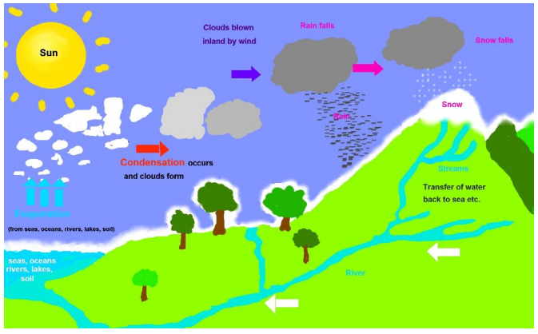
Knowledge Organiser
Science Focus | States of matter | Year 4 | Spring 1
What? (Key Knowledge)
Solid | One of the three states of matter. Solids keep their shape. The particles in a solid are very close together. Ice is the solid states of water.
Liquid | One of the three states of matter, liquids pour and take on the shape of a container. In a liquid the particles are not as close together as in the solid form.
Gas | One of the three states of matter, gases fill all available space. The particles in gas are very apart from each other and moving freely. Water vapour is a gas.
Heating | All matter is made up of particles which have energy and move. The more energy they have the more movement there is. When a solid is heated it gains energy, the particles move more and it changes to a liquid state. When more energy (heat) is applied to a liquid more movement occurs and it changes into a gaseous state. If a gas is heated it gains more energy and takes up more space (expands).
Water Cycle | This depends upon the processes of evaporation, condensation and precipitation. Precipitation is water falling from the air as rain, snow, sleet or hail. Evaporation occurs on the oceans, land, lakes and rivers. Some of the cooled water vapour condenses on small particles of dust or soot present in the atmosphere and clouds containing water droplets or ice are formed. The water droplets need to reach a certain size before they begin to fall.
Statutory requirements
Pupils should be taught to: compare and group materials together, according to whether they are solids, liquids or gases observe that some materials change state when they are heated or cooled, and measure or research the temperature at which this happens in degrees Celsius (°C) identify the part played by evaporation and condensation in the water cycle and associate the rate of evaporation with temperature.
What? (Key vocab)
Spelling | Definition
State Change | The process of change from one state of matter to another – this is a reversible change.
Melting | Changing from a solid into a liquid.
Freezing | Changing from a liquid into a solid.
Evaporation | The process of change from a liquid into a gas.
Condensation | The process of change from a gas into a liquid.
Water Cycle | The cycle of events that occur naturally in the weather systems of the Earth where water moves through its three states.
Possible experiences
Observe change of states over time. Play a game of particles – the children have to get into groups and demonstrate what the particles would look like. Group different objects into solid, liquid and gas depending on their properties. Research the melting, boiling and freezing point of different materials. Apply knowledge to the water cycle.
Diagrams and Symbols

