Slide 1
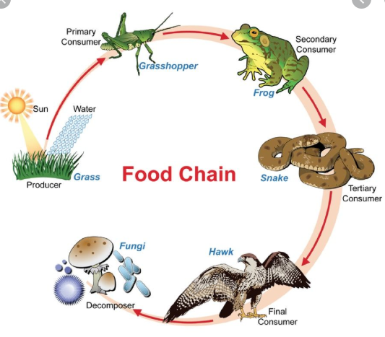
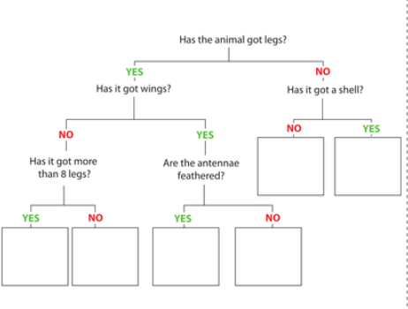
Knowledge Organiser
Science Focus | Living Things and Their Habitats | Year 4 | Summer 2
What? (Key Knowledge)
Living things can be grouped in a variety of ways. | Invertebrates and vertebrates Subdivided into (mammals, Birds, reptiles, amphibians, fish, arachnids, insects,
Use identification keys to identify | Follow the instructions to identify different plants and animals according to their features
Create own identification key | Write enquiring questions relating to the features of plants and animals to sort their features and identify it.
Food chains –can be effected by environmental issues | Plants are the primary producers in a food-chain. A snail is an example of a primary consumer -It eats the plant. A centipede is a fierce hunter, feeding on a variety of primary consumers. It is therefore known as a secondary consumer.
Recognise that environments can change and identify how it affects living things in their local environment | Habitats exist as part of a larger environment. Look for evidence as to how the environment can affect (positively and negatively) the animals that live there.
Recognise that environments can change and identify how it affects living things throughout the world | Habitats exist as part of a larger environment. Explore how environmental issues have affected different living things around the world both positive and negative– pollution, plastic pollution
Statutory Requirements
Recognise that living things can be grouped in a variety of ways Explore and use classification keys to help group, identify and name a variety of living things in their local and wider environment Recognise that environments can change and that this can sometimes pose dangers to living things
What? (Key vocab)
Spelling | Definition
Habitat | The place where organisms live
Invertebrates | Animals without backbones -Two of the most commonly known ones are arachnids (spiders) and insects.
Birds | Birds are animals that have feathers and that are born out of hard-shelled eggs.
Vertebrates | Animals with backbones - The five most well known classes of vertebrates are mammals, birds, fish, reptiles, amphibians.
Mammals | If an animal drinks milk when it is a baby and has hair on its body, it belongs to the mammal class. e.g. dogs, cats, dolphins and whales.
Fish | Fish are vertebrates that live in water and have gills, scales and fins on their body.
Reptiles | Reptiles are a class of animal with scaly skin. They are cold blooded and are born on land e.g. snakes, lizards, crocodiles, alligators.
Amphibians | Amphibians are born in the water. When they are born, they breathe with gills like a fish. But when they grow up, they develop lungs and can live on land. e.g. frogs.
Arthropods | Any animals that have more than four, jointed legs are arthropods. Insects, spiders and crustaceans.
Diagrams and Symbols
Possible experiences
Finding and classifying animals in the school environment Looking closely at the features of animals using hand lenses Visit to wildlife park to explore where living things are found and impacts of the environment on their survival

