Slide 1
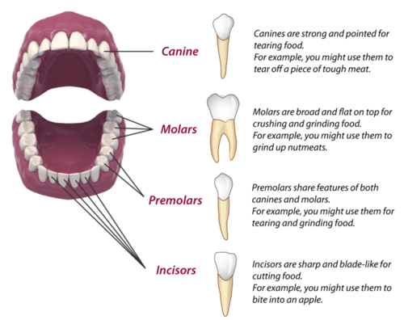
Science Knowledge Organiser
Science Focus | Animals, including humans | Year 4 | Autumn 2
What? (Key Knowledge)
The human digestive system
What is digestion? | Digestion is the way the body breaks down the food we eat into smaller parts that can be used to give the body energy
The digestive system | Mouth, tongue, pharynx, oesophagus, liver, stomach, gallbladder, pancreas, large intestine, small intestine
The digestive journey | Humans put food into their mouth Food is chewed by the teeth and mixed with saliva, swallowed and passed through the pharynx and oesophagus to the stomach. In the stomach, it is mashed into a mixture like soup and mixed with acid. The mixture passes into the small intestine, where tiny bits of food pass into the bloodstream. The remaining food goes into the large intestine. Finally, waste produce leave the body.
Human Teeth
Teeth facts | ‘Milk’ teeth grow in babies when they are about 6 months old 20 teeth grow by the time you are around 2.5 years old From about age 6 you start to lose teeth until about the age of 12 These teeth are replaced by 32 permanent teeth
Types of teeth | Incisors (front teeth for snipping and cutting food) Canines (long pointed teeth for grabbing food) Pre-molars and molars (back teeth for crushing and grinding food)
What? (Key knowledge)
Food Chains | A food chain is a diagram that shows a producer (usually a green plant or algae) and consumers (who get their food by eating plants or other animals) A consumer could be a predator, prey or both The arrow means ‘is food for’
What? (Key vocab)
Spelling | Definition
Energy | The property that gives humans strength
Waste | Unwanted substances that are eliminated from the body
Saliva | ‘Spit’ that breaks down food (especially starch) in the mouth
Acid | Contains enzymes that help break down food in the stomach
Predator | Animals which eat other animals are called predators
Prey | Animals at are eaten by other animals.
Pictures and Diagrams
Possible experiences
Compare the teeth of animals and [predict if they are carnivores, herbivores or omnivores Experiments with what can go wrong with the digestive system such as: hiccups and vomiting Making the longest food chain possible (e.g. a paper chain)

