Slide 1
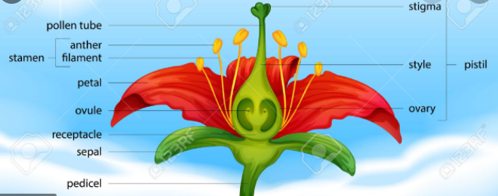
Knowledge Organiser
Science Focus | Plants | Year 3 | Summer 2
What? (Key Knowledge)
The functions of the different parts of a plant | The petals on a flower are usually bright - this is to attract bees and other insects so that they can collect pollen to make seeds. The seeds are then able to grow to make new plants. This is called germination. Leaves use carbon dioxide and sunlight to make food for the plant.
What do different plants need to grow? | Air, water, sunlight, nutrients from the soil, room to grow, suitable temperature The amount of each of these may vary depending on the type of plant. For example, cacti need less water than other plants.
How is water transported within plants? | The process of water transportation is the way water moves through a plant. The roots absorb water from the soil. The stem transports water to the leaves. Water evaporates from the leaves.
What should I already know?
-Which things are living and which are not. -A variety of common wild and garden plants, including deciduous and evergreen trees and how to identify them. -Plants need water, light and a suitable temperature to grow and stay healthy. -Plants and animals depend on each other to survive.
What? (Key vocab)
Spelling | Definition
Absorb | to soak up or take in
Germination | if a seed germinates or if it is germinated, it starts to grow
Fertilisation | in plants, where pollen meets the ovule to form a seed
Carbon dioxide | a gas produced by animals and people breathing out
Pollen | To pollinate a plant or tree means to fertilise it with pollen. This is often done by insects
Transported | taking something from one place to another
Stigma | the top of the centre part of a flower which takes in pollen
Dispersed | scattered, separated, or spread through a large area
Diagrams and Symbols
Possible experiences
 | Opportunities to experiment with seeds and flowering plants. Class plant, children to note and record observations. Possible visit to local gardens to explore the life cycle of a flowering plant.

