Slide 1
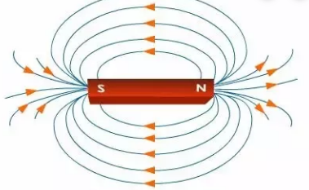
Knowledge Organiser
Science Focus | Forces and magnets | Year 3 | Autumn 2
What? (Key Knowledge)
How does magnetism work?
Magnetic metals | Not all metals are attracted to magnets; only those containing iron, steel and nickel.
Magnetic poles | Magnets have two poles, a north and a south pole. The pole is where the pull of the magnet is strongest. When opposite poles are near to each other they will attract, whereas when the same poles are near to each other they will repel.
Distance | Magnetic forces can act at a distance depending on how strong the magnetic pull is.
Magnetic force | When two magnets are close, they create pushing or pulling forces on one another.
Forces | Forces are pushes and pulls in a particular direction. Forces are shown by arrows in diagrams. The direction of the arrow shows the direction in which the force is acting. The bigger the arrow, the bigger the force.
Statutory requirements
- Compare how things move on different surfaces. - Notice that some forces need contact between two objects - Observe how magnets attract or repel each other and attract some materials and not others. - Compare and group together a variety of everyday materials on the basis of whether they are attracted to a magnet, and identify some magnetic materials . - Describe magnets as having two poles. - Predict whether two magnets will attract or repel each other, depending on which poles are facing.
What? (Key vocab)
Spelling | Definition
Bar and horseshoe magnets | A magnet is an object that is made of materials that create a magnetic field. Magnets have at least one north pole and one south pole.
Attract | If you put two magnets together with different poles pointing towards one another, the magnets will pull towards each other. We say they attract each other.
Repel | If you try to put two magnets together with the same poles pointing towards one another, the magnets will push away from each other. We say they repel each other.
Magnetic field | The region of space where magnetism can be detected.
North and south pole | All magnets have a north and a south pole (note: lowercase).
Magnetic | Something that attracts or repels iron, steel or nickel objects.
Diagrams
Possible experiences
Challenge the children to make fridge magnets. They could use recycled materials, decorate them and attach a magnet to them. http://www.sciencekids.co.nz/gamesactivities/detectivescience/magnets.html This online game will allow the children to apply their knowledge of magnet poles. See which metal objects around the house are attracted to a magnet and which ones are not – are all magnetic materials shiny?

