Slide 1
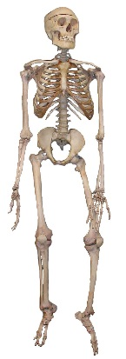
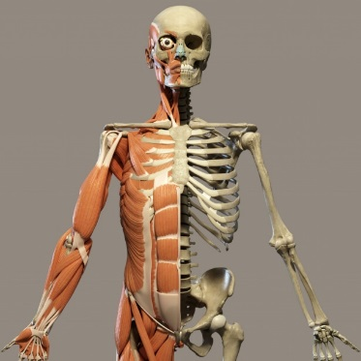
Knowledge Organiser
Science Focus | Animals, including humans | Year 3 | Autumn 1
What? (Key Knowledge)
Nutrition
Things humans need to be healthy | To have a balanced diet of the right amount of different types of food and drink To exercise regularly To be hygienic
What is nutrition? | Nutrition means animals getting the food they need to grow and be healthy.
Can we make our own food? | No. Humans and animals can’t make their own food. They get food by either growing it, hunting it or gathering it.
What is meant by hunting and gathering food? | Humans can hunt other animals to eat and they also find foods grown in the wild.
Skeleton and Muscles
What is a skeleton? | A skeleton is a structure of bones that supports the body of a person or animal.
Parts of the skeleton | Skull, clavicle, scapula, rib cage, humerus, spinal column, pelvis, ulna, radius, femur, tibia, fibula
Function of the skeleton | Protection, support, movement
What is a muscle? | A soft tissue in the body that contracts and relaxes to cause movement of the skeleton
Statutory requirements
Identify that animals, including humans, need the right types and amount of nutrition, and that they cannot make their own food; they get nutrition from what they eat Identify that humans and some animals have skeletons and muscles for support, protection and movement.
What? (Key vocab)
Spelling | Definition
Tissue | A tissue is part of the body that is made of similar cells
Contact | When a muscles becomes smaller, shorter and tighter
Nutrition | The process of obtaining the food needed for health and growth
Vitamins and minerals | Substances that are found in foods we eat. Your body needs them to work properly, so you grow and develop just like you should.
Fat | Fats fuel the body and help absorb some vitamins. They also are the building blocks of hormones and they insulate the body.
Protein | Proteins grow, maintain, and replace the tissues in our bodies.
Carbohydrate | Sugars and starches, which are found in foods such as starchy vegetables, grains, rice, breads, and cereals.
Diagrams
Possible experiences
Grouping animals with or without skeletons Classifying food by how the human ‘gets’ them Use blue-ac to show the need for warming up muscles Experiments to find out which is the strongest muscle group Test relationships in the body e.g. does arm span = height

