Slide 1
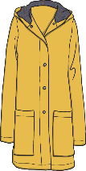
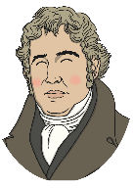
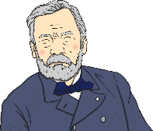
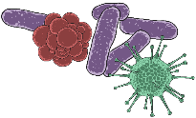
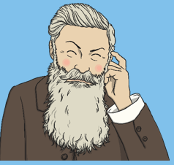
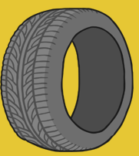
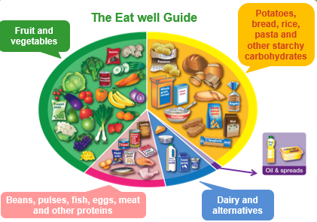
Knowledge Organiser
Science Focus | Scientists and Inventors | Year 2 | Summer Two
What? (Key Knowledge)
Louis Pasteur | Louis’ experiments convinced people that germs do spread diseases, and do not just appear. We can remove germs by washing our hands for 20 seconds using warm soapy water.
Charles Macintosh | Waterproof fabric was invented by a scientist called Charles Macintosh. His invention was so important that raincoats are named after him.
Eat well Plate | A guide that shows how much of what we eat should come from each food group to achieve a healthy, balanced diet.
John Dunlop | The first person to think of using rubber to make tyres.
Statutory requirements
This is a topic that links to several areas of the science curriculum that have already been covered during the year. - See individual Yr2 Science Knowledge Organisers for details. The children will be involved in thinking scientifically and applying prior knowledge to new learning opportunities.
What? (Key vocab)
Spelling | Definition
Germs | Tiny micro-organisms that can only be seen under a microscope
Waterproof | A material that doesn’t absorb water so things can keep dry.
Inventor | A person who creates something new (an invention).
Properties | What a material is like i.e. flexible, transparent, soft, rigid etc.
Balanced meal | A meal that has the correct amount of food from each food group.
syringe | Equipment used for measuring small amounts of liquids.
Pictures and Diagrams
Charles Macintosh Louis Pasteur John Dunlop
Possible experiences
Make a handwashing video and post on the Midfield Website. Invent something new and then promote your product ‘Dragon’s Den’ style! Plan and make a healthy balanced meal and invite parents in to dine.

