Slide 1
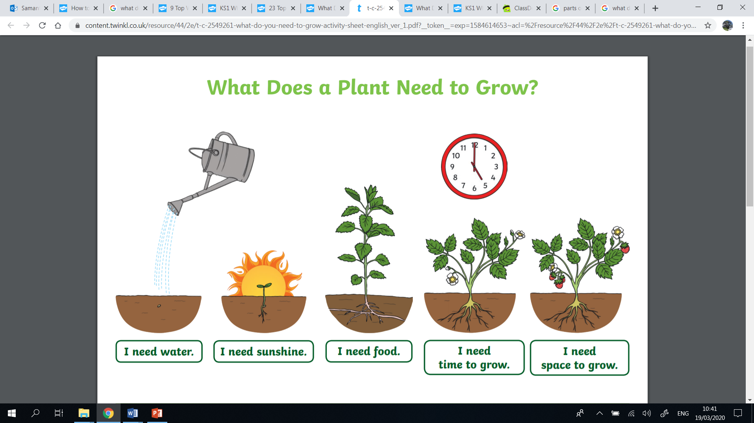
Knowledge Organiser
Science Focus | Plants | Year 2 | Spring 2
What? (Key Knowledge)
Structure of plants - In most plants the part above the ground is the shoot system and the part below is the root system.
Leaf | The leaf makes food for the plant by photosynthesis.
Stem | The stem supports the leaves and is also part of the plant’s transport system.
Buds | Buds are undeveloped shoots.
Flowers | Some buds produce flowers. These are shoots specialised for reproduction.
Roots | Roots anchor the plant to whatever material it is growing on or in. They also absorb water and other chemicals that the plant needs in order to live healthily and grow normally.
Requirements of plants
Sunlight | All plants need light from the sun to grow well. Some plantgs need lots of sunlight and some need only a little.
Water | All plants need water to grow. Without water, seeds and bulbs will not germinate.
Temperature | This is how warm or cold something is. Different plants like cooler or warmer temperatures.
Nutrition | Food or nourishment. Plants make their own food in their leaves using sunlight.
Statutory requirements
- Observe and describe how seeds and bulbs grow into mature plants - Find out and describe how plants need water, light and a suitable temperature to grow and stay healthy.
What? (Key vocab)
Spelling | Definition
Germination | When conditions are right, the seed soaks up water and swells, and the tiny new plant bursts out of its shell.
Sprout | When a plant sprouts, it grows new shoots.
Shoot | A shoot grows upwards from the seed or plant to find sunlight.
Seed dispersal | The movement, spread or transport of seeds away from the parent plant. They can be moved by the wind or animals.
Blossom | The flowers that appear on a tree before the fruit.
Possible experiences
Try growing plants in different conditions. Change one variable e.g. light, water or nutrients and see how this affects growth. Visit a garden to find and identify flowering plants. Take some photographs and have children label them when they get back showing the different parts of the plant. Make a model of different types of plants including vegetables and trees to help children become more familiar with the main parts of plant.
Diagrams

